Slide 1





XPLORA INNOVATHON 2026
MOOD BASED
MANAGEMENT SYSTEM
Idea Title : Euphora City – Feel-Good Smart Urban Ecosystem
Team Name : BRAHMISH
University / Organization / College Name : Centurion University of Technology and Management
Domain : Smart Infrastructure & Urban Development
Idea Category: Software

Slide 2
XPLORA INNOVATHON 2026
PROBLEM STATEMENT
Problem
Cities designed for vehicles & buildings, not human well-being
High stress, pollution, noise, overcrowding
Lack of green and relaxation spaces
Stressful daily commutes & social isolation
Who is Affected
Students, employees, families, elderly
Businesses facing burnout & low productivity
Healthcare systems & urban society
Why Important
Rising mental health issues
Reduced productivity & creativity
Higher healthcare costs
Rapid urban population growth
Current Limitations
Smart cities focus on traffic & surveillance, not emotions
Insufficient parks & pedestrian zones
Poor integration of nature + technology
Limited citizen participation
@Xplora Innovathon Idea Submission - Template

Slide 3
XPLORA INNOVATHON 2026
PROPOSED SOLUTION
Solution Overview
A city designed to improve mood, comfort, and happiness
Combines AI + Nature + Sensory Design + Community Voting
How It Works
AI-based adaptive lighting & soundscapes
Mood-based public zones
Smart green architecture
Citizen participation app
Key Features
Feel-Good Streets
Emotional Public Spaces
Sensory Walkways
Smart Silent Transport
Micro-Parks every 300m
@Xplora Innovathon Idea Submission - Template

Slide 4
XPLORA INNOVATHON 2026
WORKFLOW & IMPLEMENTATION
System Workflow
Sensors collect environment & crowd data
AI analyzes mood & comfort indicators
Infrastructure adapts lighting, sound, temperature
Citizen app allows voting & feedback
Technology Stack
AI / Machine Learning
IoT Sensors
Mobile App Platform
Smart Lighting & Renewable Energy Systems
Implementation Approach
Phase 1: Prototype Smart Street
Phase 2: Mood Zones & Parks
Phase 3: Full Smart District
@Xplora Innovathon Idea Submission - Template

Slide 5
XPLORA INNOVATHON 2026
INNOVATION & FEASIBILITY
Innovation
First infrastructure focused on emotional well-being
Integration of psychology + urban planning + AI
Community-driven city customization
Feasibility
Uses existing IoT & renewable tech
Modular implementation possible
Scalable district-wise deployment
Challenges
Initial cost
Data privacy concerns
Public adoption
Solutions
Public-private funding
Anonymous data systems
Awareness campaigns
@Xplora Innovathon Idea Submission - Template

Slide 6
XPLORA INNOVATHON 2026
Main Features
Customers can register manually or upload a PDF and the system auto-extracts their details.
The system tracks customer mood and gives personalized suggestions.
QR codes are generated so customers can easily access their profile.
Admin has a dashboard to monitor everything in real time.

Slide 7
XPLORA INNOVATHON 2026
Database Models
The system uses multiple database tables.
Customer table stores personal information.
Mood table stores emotional data and intensity.
FoodItem stores menu and inventory.
Transaction stores purchase history.
Feedback stores customer reviews.
This structure helps keep data organized and secure.

Slide 8
XPLORA INNOVATHON 2026
AI Suggestion Engine
The AI engine is rule-based.
It gives suggestions like music, lighting, snacks, or activities based on mood.
It also checks mood history.
If a user is repeatedly sad or stressed, it suggests professional support.
This improves emotional well-being and personalization.

Slide 9
XPLORA INNOVATHON 2026
Additional Functionalities
“Customers can submit feedback and ratings.”
“The system supports mobile APIs.”
“QR scanning provides quick access.”
“Secure login ensures privacy and safety.”

Slide 10
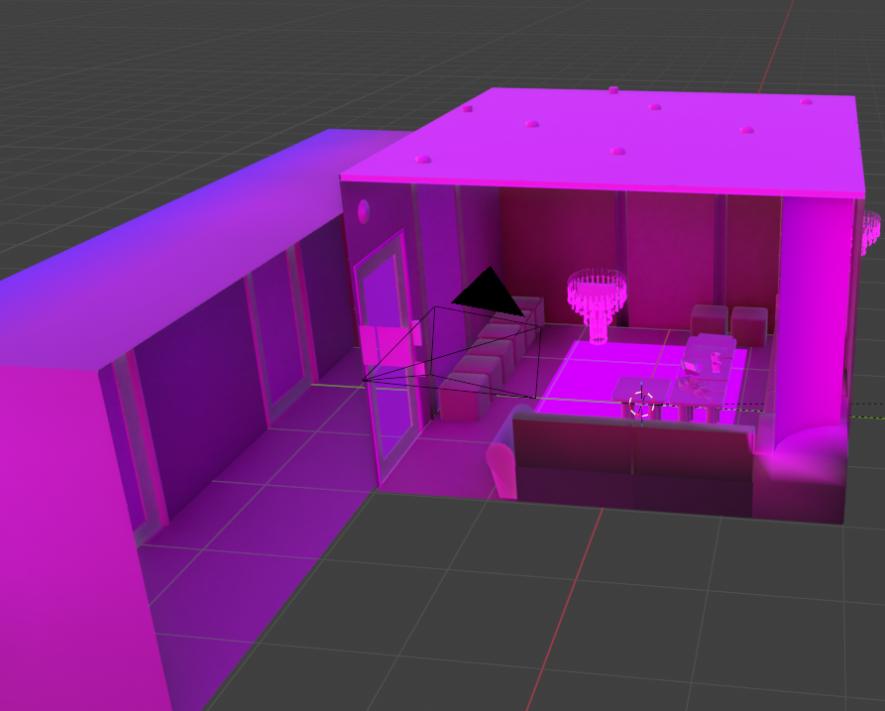
XPLORA INNOVATHON 2026
EXCLUSIVE MEMBER’S ROOM

Slide 11
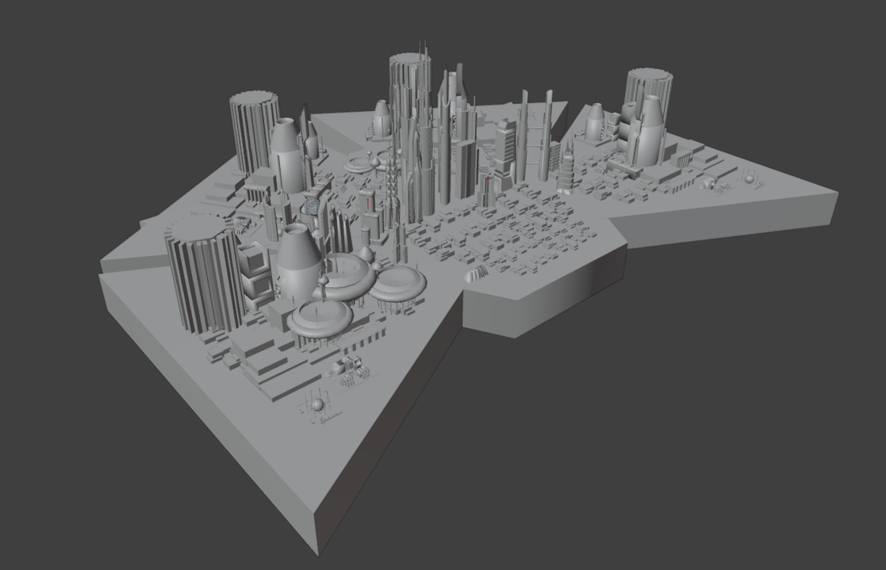
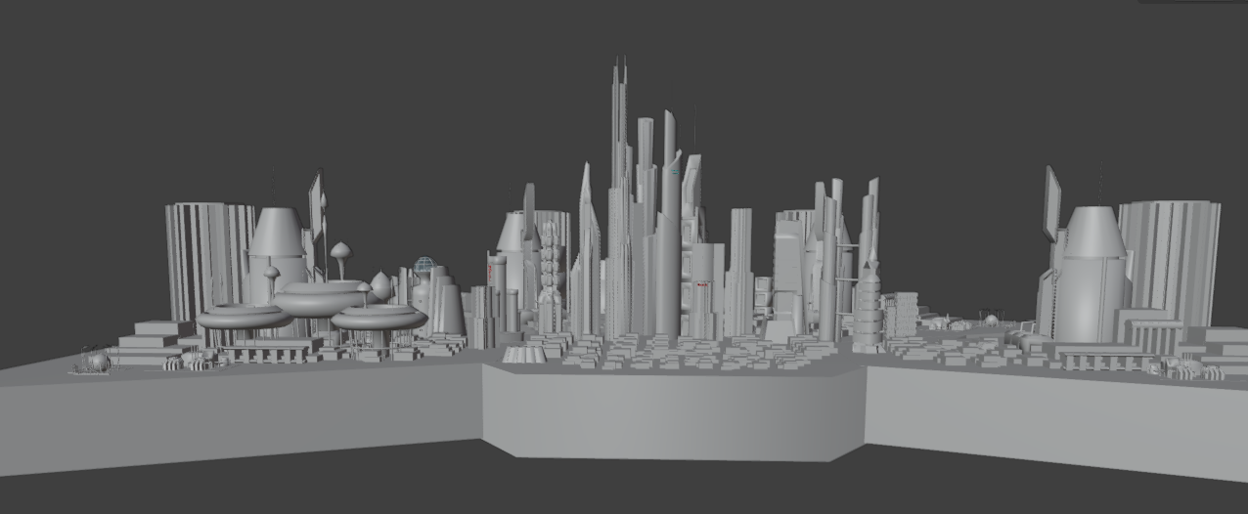
XPLORA INNOVATHON 2026
EUPHORIA CITY

Slide 12
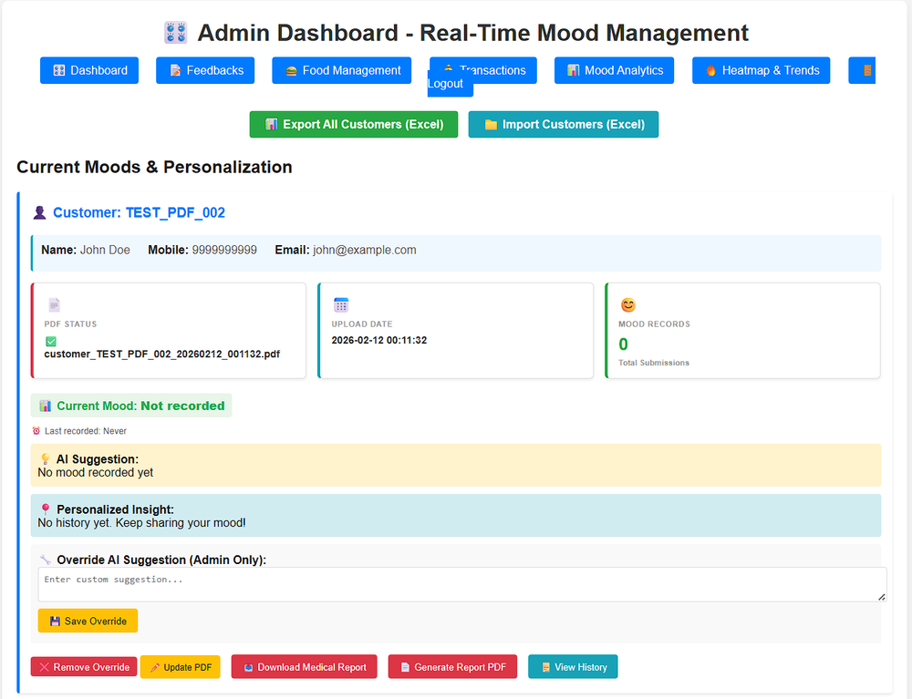
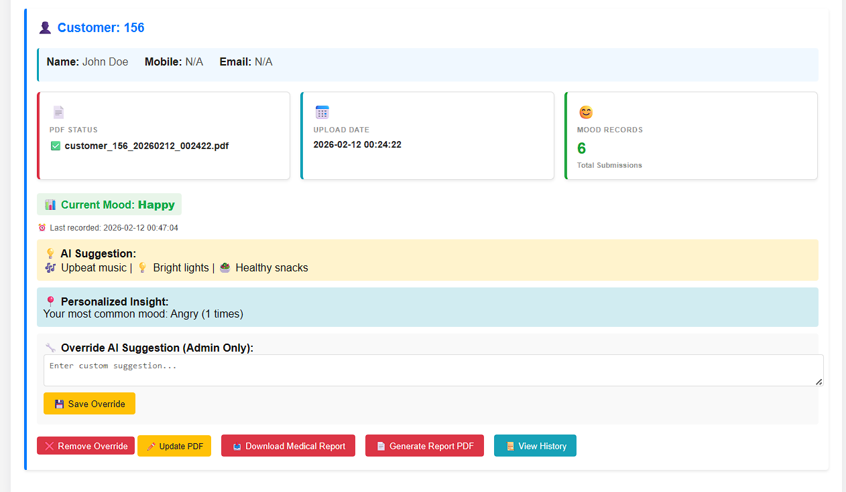
XPLORA INNOVATHON 2026
Admin’s Interface

Slide 13
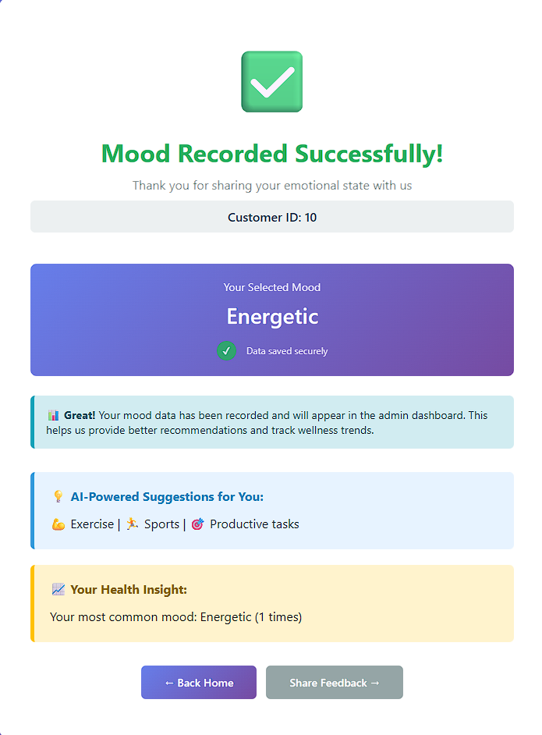
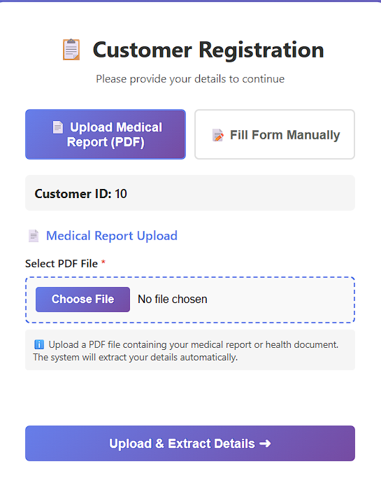
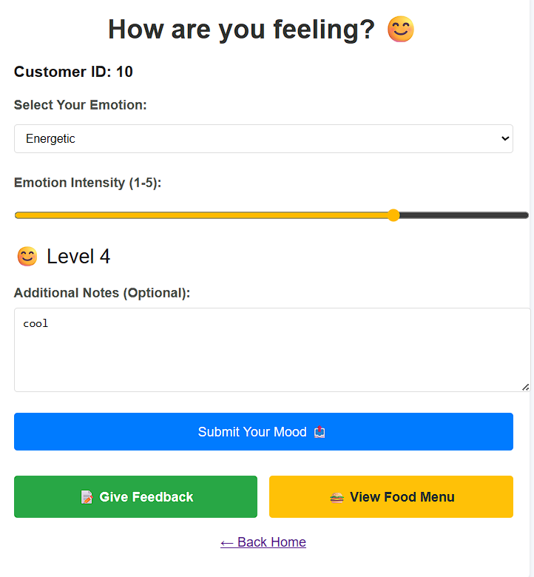
XPLORA INNOVATHON 2026
Customer’s Interface

Slide 14
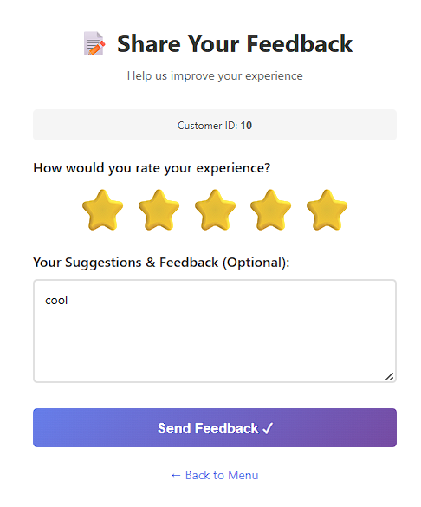

XPLORA INNOVATHON 2026
Customer’s Interface

Slide 15
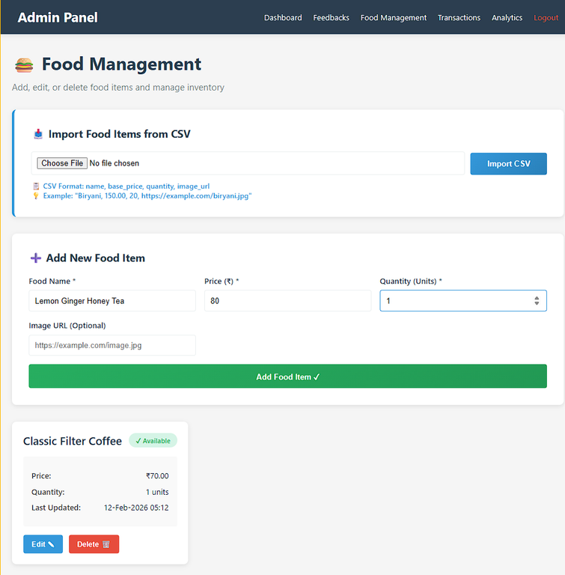
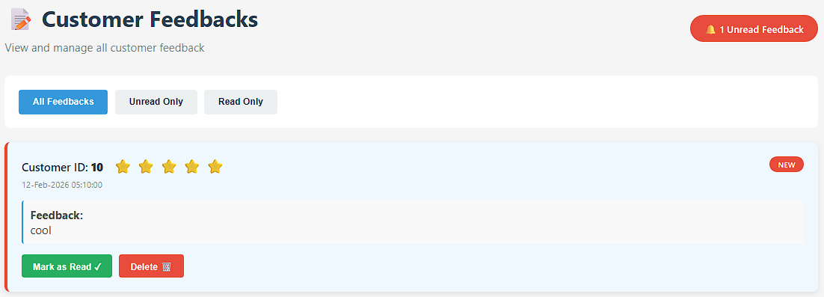
XPLORA INNOVATHON 2026
Admin’s Pannel

Slide 16
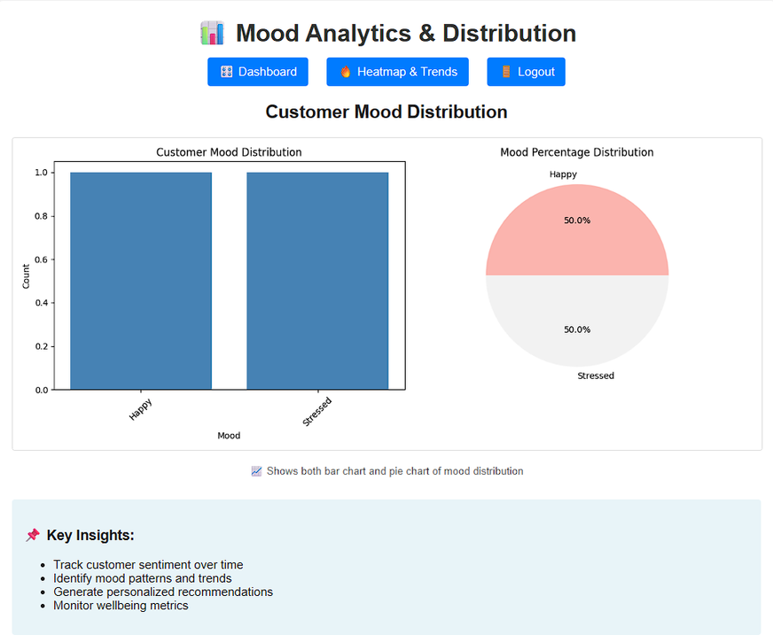
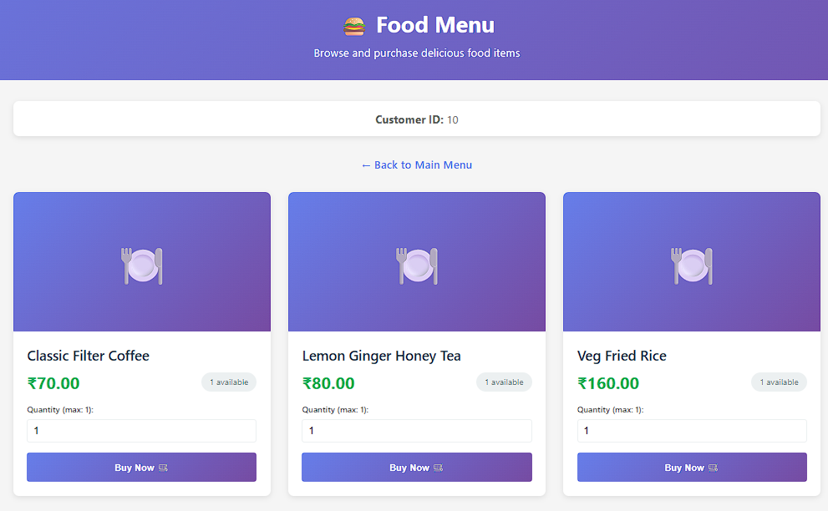
XPLORA INNOVATHON 2026
Admin’s Pannel

Slide 17
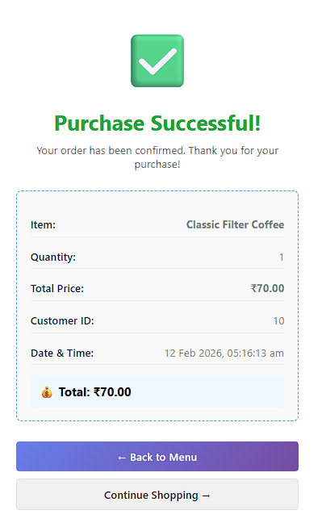
XPLORA INNOVATHON 2026
Admin’s Pannel

Slide 18

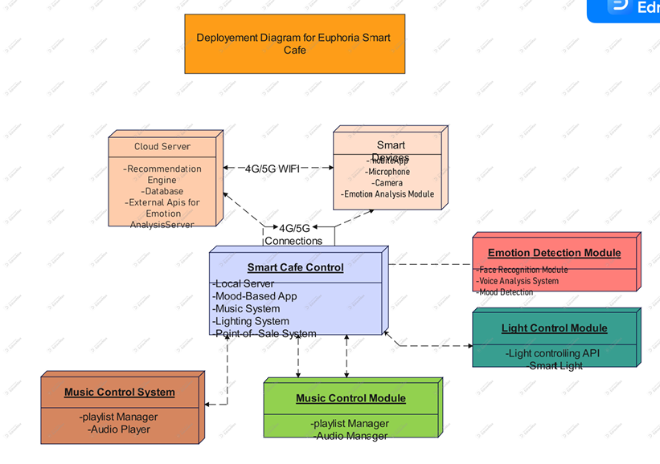
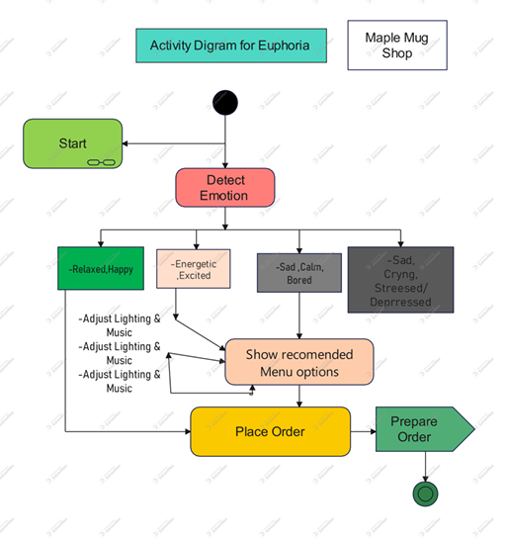
XPLORA INNOVATHON 2026
UML Diagram

Slide 19
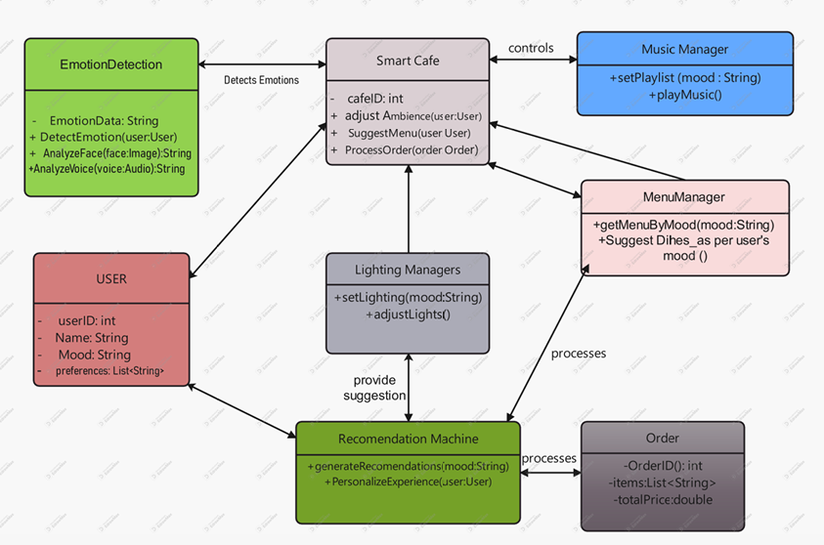
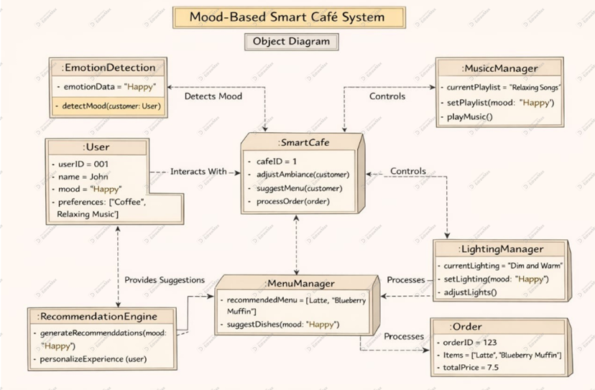
XPLORA INNOVATHON 2026
UML Diagram

Slide 20
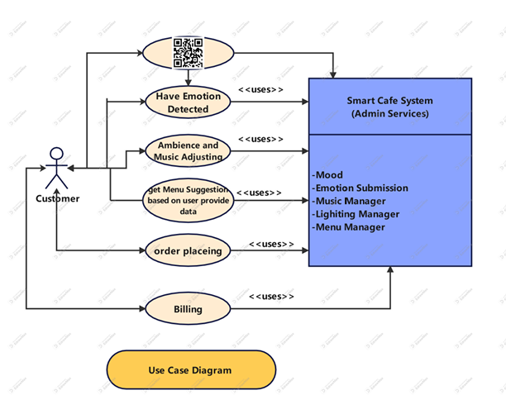
XPLORA INNOVATHON 2026
UML Diagram

Slide 21
XPLORA INNOVATHON 2026
IMPACT & BENEFITS
Expected Impact
Reduced stress & improved mental health
Better urban lifestyle quality
Beneficiaries
Urban residents
Businesses & employees
Elderly & children
Social Benefits
Stronger community bonding
Increased outdoor activity
Economic Benefits
Higher productivity
Tourism attraction
Lower healthcare costs
Environmental Benefits
Cleaner air & reduced heat islands
Sustainable energy usage
RESEARCH & REFERENCES
@Xplora Innovathon Idea Submission - Template

Slide 22
XPLORA INNOVATHON 2026
FUTURE ASPECTS
AI & Machine Learning: Smarter mood prediction and personalized suggestions.
Facial Emotion Detection: Automatic mood detection using camera.
Mobile App: Android/iOS app with notifications.
Cloud Integration: Multi-branch access and better data security.
Online Payments: UPI / Card payment support.
IoT Smart Environment: Auto control of lights, music, AC based on mood.
Advanced Analytics: Predict food demand and customer trends.
The project can grow into a fully AI-powered smart restaurant and emotional wellness platform.
@Xplora Innovathon Idea Submission - Template

Slide 23
XPLORA INNOVATHON 2026
RESEARCH & REFERENCES
RESEARCH & REFERENCES
References
Smart City Urban Planning Reports
WHO Mental Health & Urban Living Studies
IoT Smart Infrastructure Case Studies
Sustainable Architecture Journals
AI in Public Space Design Articles
@Xplora Innovathon Idea Submission - Template

Slide 24
XPLORA INNOVATHON 2026
Conclusion
RESEARCH & REFERENCES
This system combines emotional intelligence with restaurant management.
It improves customer satisfaction and operational efficiency.
It is scalable and can be used in cafes, restaurants, or wellness centers.
Overall, it is a smart, modern, and practical solution.
@Xplora Innovathon Idea Submission - Template

